Slide 1

E-Commerce Analytics Performance & Bottleneck Review
Data-Driven Strategies for Logistics and Revenue Growth Presented by Shoaib Akhtar Shaikh

Slide 2

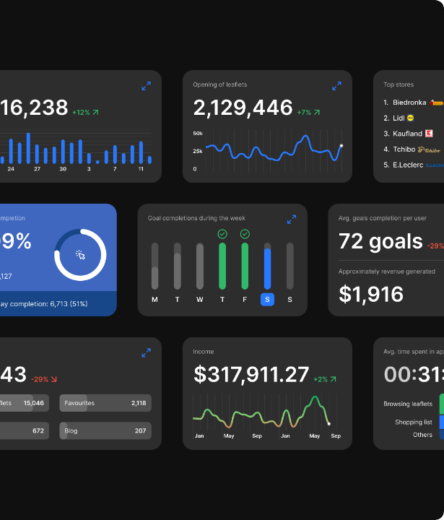
Platform Overview
Executive Summary
Generated R$ 13.59M in total revenue across 99.44K orders in the 2017-2018 operational period.
Successfully acquired 96.1K unique customers, indicating immense market penetration.
Revenue is heavily concentrated in the Southeast region (São Paulo & Rio de Janeiro).
The Bottleneck: Our logistics network is struggling to efficiently manage this high volume, leading to operational friction.

Slide 3





The True Cost of Late Deliveries
The Logistics Crisis
Satisfaction Drop
Our dashboard flagged a critical 7.87% Late Delivery Rate (approx. 7,827 orders).
This severe drop in satisfaction directly damages our brand reputation and customer retention.
We ran a Two-Sample T-Test, confirming mathematically that late deliveries cause review scores to crash.
4.21
2.57
VS
On Time
Late Delivery
p-value < 0.05 (Statistically Significant)

Slide 4
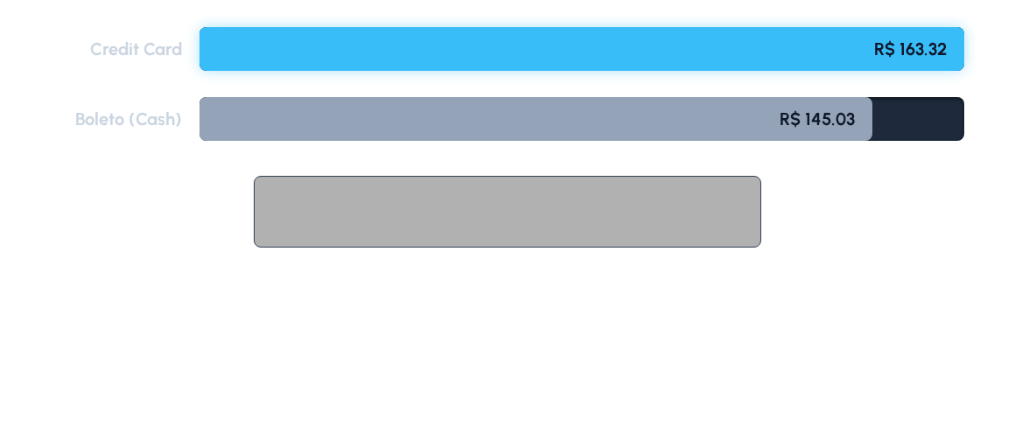
Payment Optimization
Are we maximizing revenue per transaction? Yes. A T-Test confirmed that Credit Card users spend a statistically significant amount more per order than Boleto users. The ability to pay in installments removes price friction for the buyer, leading to larger cart sizes and higher overall revenue.

Slide 5




Strategic Next Steps
Audit Freight Carriers
Delist High-Friction Items
Incentivize Credit Cards
Identify the specific carrier(s) causing the high late delivery rate in the critical Southeast market and penalize or renegotiate their contracts.
Immediately review the top 5 worst-rated products identified on the dashboard and consider delisting them to protect brand reputation.
Offer small, targeted discounts (e.g., "5% off if you pay with Credit Card") to shift Boleto users to Credit Cards, naturally lifting our AOV.

Slide 6
Questions & Discussion
Thank you for your time.

